Slide 1
BITS Pilani presentation
K.Anantharaman
kanantharaman@wilp.bits-pilani.ac.in
28/10/23
SE ZG544 S1-23-24 Agile software processes

Slide 2
SE CZ 544 , Agile software processes
CS-10 – Agile Metrics and Tools
28/10/23
SE ZG544 S1-23-24 Agile software processes

Slide 3
Agile Metrics
Examples:
Velocity, Lead time, Cycle time, Charts, Escape defects and so on.
Helps to assess the quality of a product and track team performance.
The Concept:
Define Metrics that can be used by Agile teams and Team management, Agile metrics that matter.
The Opportunity
Reduced costs, Increase Product Quality, Increased team satisfaction
The Potential
Auto Generate using exposed APIs provided by various PM tools.
SE ZG544 S1-23-24 Agile software processes
Source: Prachi Maini, Manager, QA Engineering, Morningstar, Inc.
28/10/23

Slide 4
Quantitative & Qualitative Metric
Quantitative Metric
Measurement number: Lead time, Number of defects ….
Qualitative Metric
Based on subjective opinion: Maintainability, Team happiness index …
Source:https://www.infoq.com/articles/metrics-agile-teams/
28/10/23
SE ZG544 S1-23-24 Agile software processes

Slide 5
An example Quantitative Metric
Example: Lead time is a useful quantitative statistic for evaluating team performance.
Determinant metrics:
A set of measurements related to a specific measurement
Associated metrics:
Flow efficiency (wait time)
Speeding tickets(%), ( Tickets moves through multiple statuses)
Total sprint completion (Committed vs Actual Story points)
Defects returned from QA(%)
Escape defects(%)
Bug fixing Vs working on feature (% time)
Ready
Progress
Done
Cycle Time
Lead time
28/10/23
SE ZG544 S1-23-24 Agile software processes

Slide 6
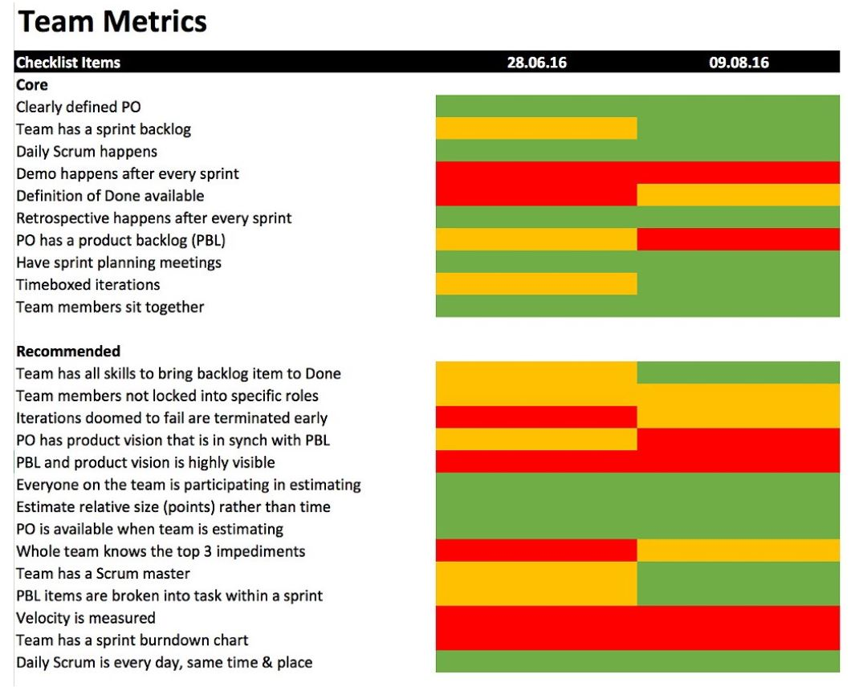
An example - Good Qualitative Agile Metrics: Team Adoption to Agile
Sprint N
Sprint N+1
Green: It worked for the team.
Orange: Room for improvement.
Red: Didn’t apply or the practice is failing
https://www.crisp.se/wp-content/uploads/2012/05/Scrum-checklist.pdf
28/10/23
SE ZG544 S1-23-24 Agile software processes

Slide 7
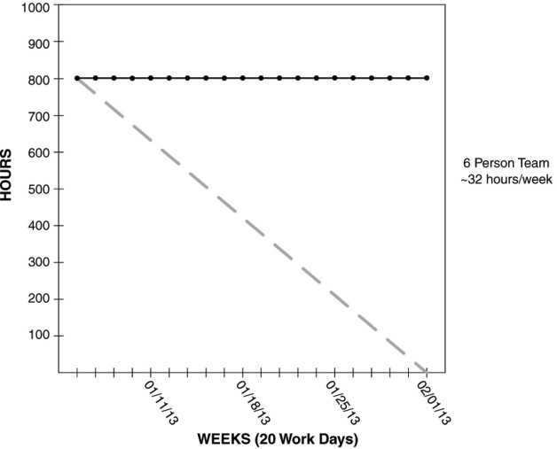
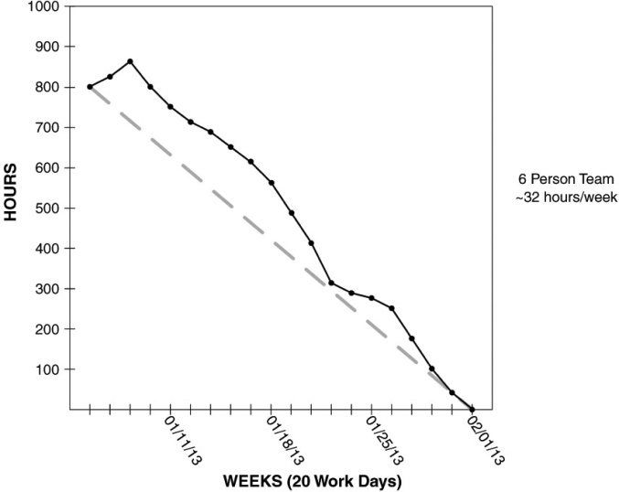
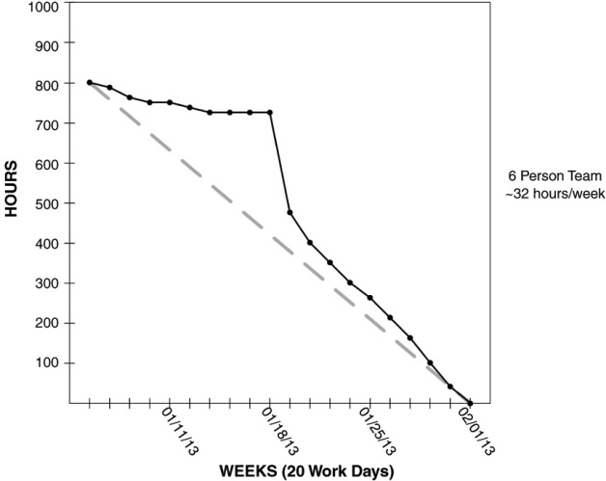
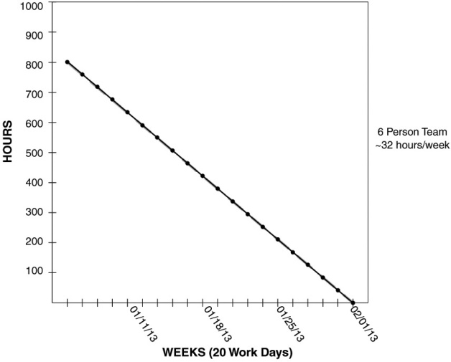
WHAT ARE SOME TRENDS OF BURNDOWN CHARTS AND WHAT DO THE PATTERNS INDICATE?
Uptick: New tasks/Stories added. Issue if continues.
Flatline: Multiple reasons. Impediments, Task/Stories added at the same rate as work complete.
Perfect line: Team trying to align with expectations
Sharpdrop: Team not updating the chart/ Pointed removed
28/10/23
SE ZG544 S1-23-24 Agile software processes

Slide 8
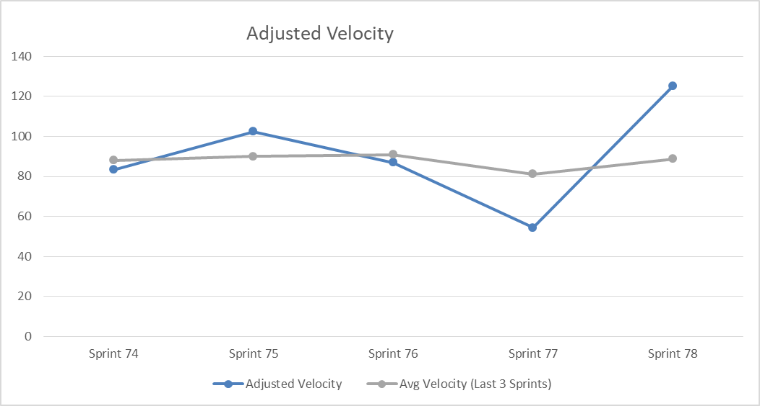
Velocity
Capacity | Sprint 74 | Sprint 75 | Sprint 76 | Sprint 77 | Sprint 78
Team Size | 8 | 8 | 8 | 8 | 8
Available Days | 80 | 80 | 80 | 80 | 80
Unavailable Days | 10 | 12 | 11 | 5 | 0
Net Days (Capacity) | 70 | 68 | 69 | 75 | 80
Velocity
Total Points Completed | 73 | 87 | 75 | 51 | 125
Adjusted Velocity | 83 | 102 | 87 | 54 | 125
Avg Velocity (Last 3 Sprints) | 88 | 90 | 91 | 81 | 89
Source: Prachi Maini, Manager, QA Engineering, Morningstar, Inc.

Slide 9
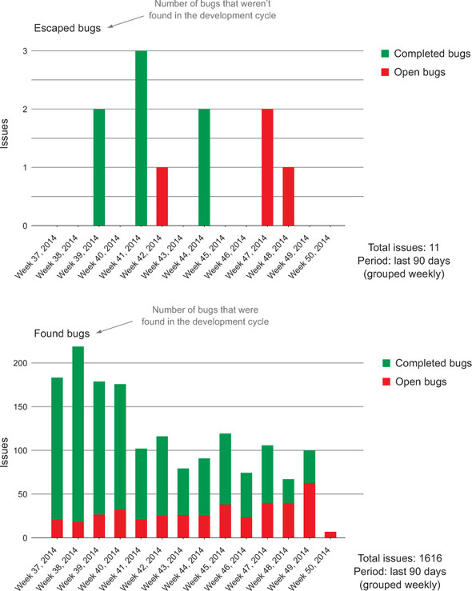
Bug counts
Source: Agile Metrics in Action: How to measure and improve team performance by Christopher W. H. Davis , Published by Manning Publications, 2015
28/10/23
SE ZG544 S1-23-24 Agile software processes

Slide 10
Summary
Metrics never convey the whole picture. Management by metrics and dashboards needs to be supplemented with management by context and conversations.
Stop measurements that lead to counterproductive behavior and stop at measurements (i.e., don’t continue to targets) that lead to desired behavior.
Prefer outcome-oriented metrics to activity-oriented ones. Prefer aggregate metrics to fine-grained ones.
Get comfortable with lagging (or trailing) indicators. When fast feedback is available, lagging indicators are a reliable alternative to speculative leading indicators.
28/10/23
SE ZG544 S1-23-24 Agile software processes

Slide 11
Quiz

Slide 12
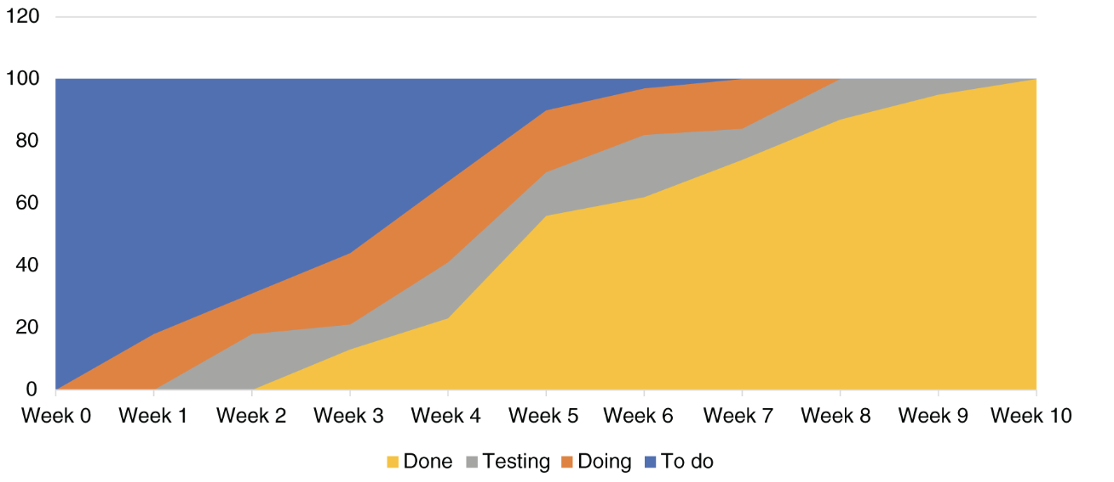
Cumulative flow diagram Q1: What to Watch for?
3
1
4
2

Slide 13
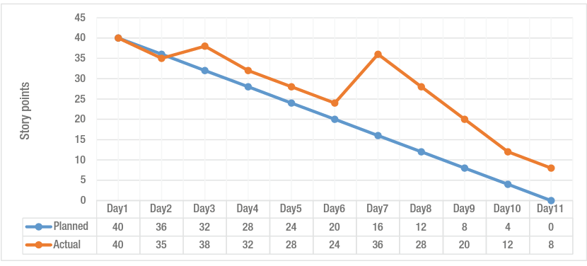
Project Progress: Q2: What to Watch for?
Burndown chart
28/10/23
SE ZG544 S1-23-24 Agile software processes

Slide 14
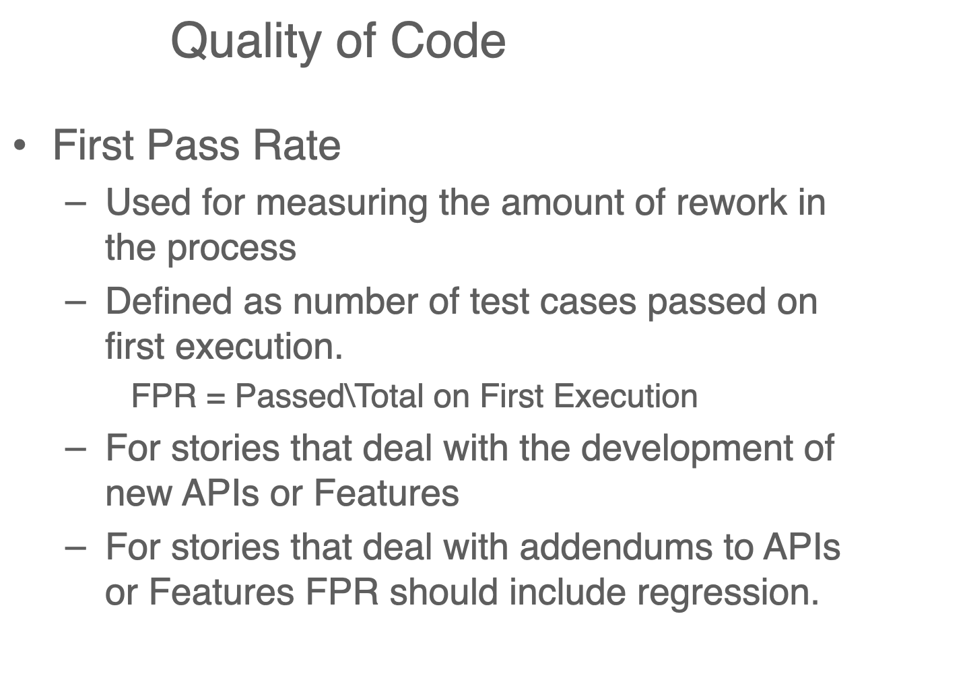
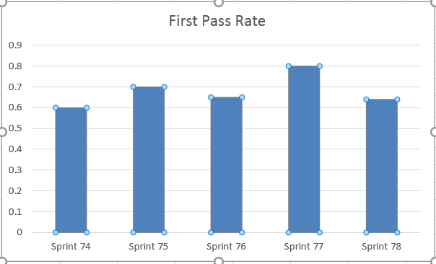
Q2
How do you connect this measure to production defects?
28/10/23
SE ZG544 S1-23-24 Agile software processes

Slide 15
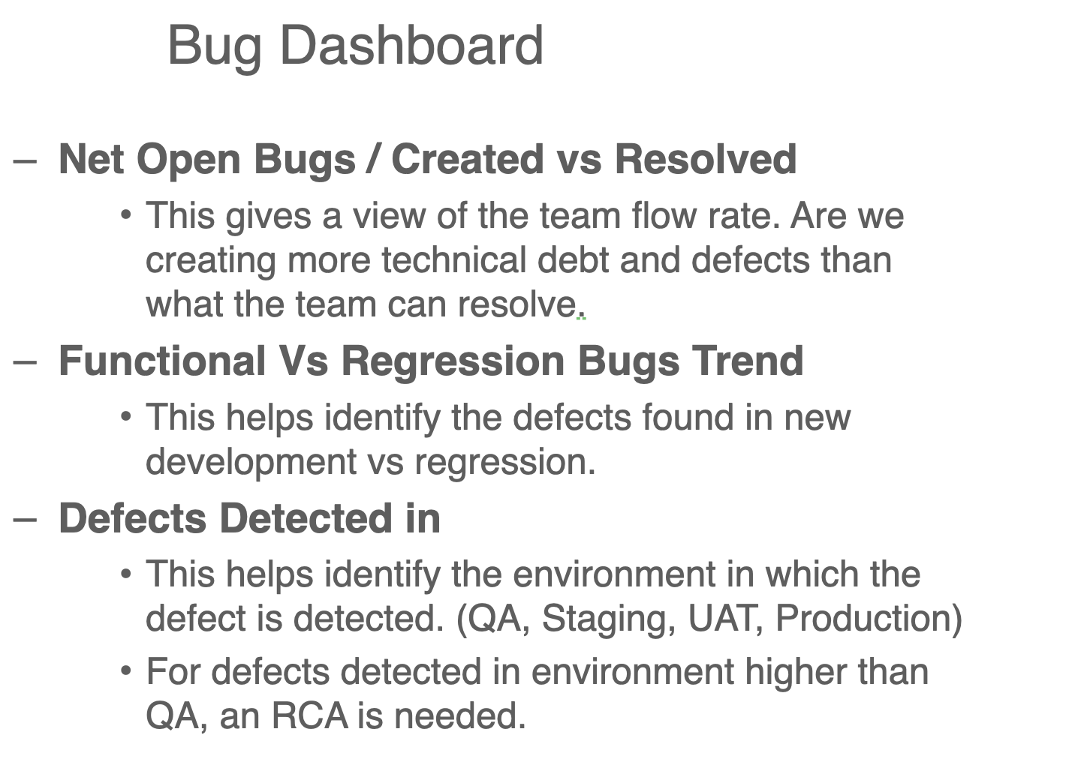
Q3
28/10/23
SE ZG544 S1-23-24 Agile software processes

Slide 16
Additional Notes - Measuring Agile Performance
28/10/23
SE ZG544 S1-23-24 Agile software processes

Slide 17
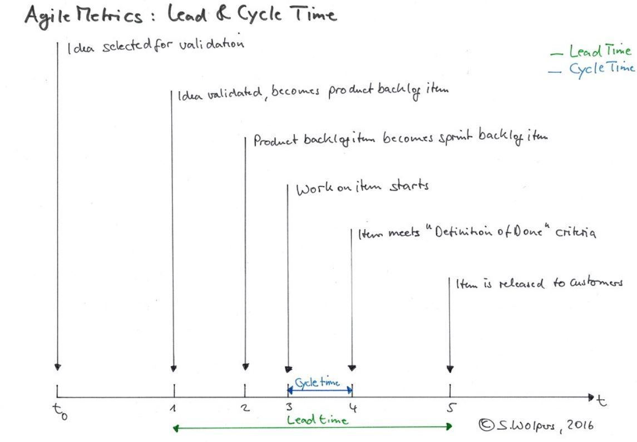
Good Quantitative Agile Metrics: Lead Time and Cycle Time
Important to measure the things that drive/determine Lead Times.
Levers that teams can actively (e.g. determinant metrics like Flow Efficiency).
28/10/23
SE ZG544 S1-23-24 Agile software processes

Slide 18
Most common and meaningful metrics for Team SI
Simple SI metrics | Metric | Comment
Overall SI goal metrics | Lead Time, Cycle Time | Good measures of overall Time to Value
Determinant metrics:
Best practice and tool use | Speeding tickets (%) | Tickets that have been moved through multiple Statuses (e.g. in Jira) after the event (so there is no real visibility of workflow stages)
Timing accuracy | Total Sprint Completion (%) | Percentage of completed story points for a given sprint(s). The factor takes into account story points added once a sprint has started.
SE ZG544 S1-23-24 Agile software processes
Source:https://www.infoq.com/articles/metrics-agile-teams/
28/10/23

Slide 19
Most common and meaningful metrics for Team SI …
Simple SI metrics | Metric | Comment
Productivity | Flow efficiency (%) | Percentage of time spent active versus inactive within a workflow
 | Return rate (%) | Percentage of tickets returned from QA (for whatever reason) during the dev process. This generates Rework.
 | % Time bug fixing (The ratio of fixing work to feature work.) | Percentage of time a team spends bug fixing versus feature contribution.
 | Number of defects escaping to production. | This is category of fixing the work.
SE ZG544 S1-23-24 Agile software processes
Source:https://www.infoq.com/articles/metrics-agile-teams/
28/10/23

Slide 20
Most common and meaningful metrics for Team SI …
Simple SI metrics | Metric | Comment
Team Wellness | Team Happiness Team Sprint Effectiveness Rating | Self Assessment tests: Individual engineers polled each Sprint/cycle.
SE ZG544 S1-23-24 Agile software processes
Source:https://www.infoq.com/articles/metrics-agile-teams/
28/10/23

Slide 21
The Importance of Metrics to Agile Teams
The philosophy of Continuous Improvement (CI) is central to Agile.
CI- should not be imposed and driven top-down – instead it should be led by Agile teams themselves, so Self-Improvement (SI) is a more suitable terminology.
SI is hard requires organization leadership long term support, recognition and suitable framework. Crucially,
A set of meaningful and agreed Agile metrics to track performance improvement over time; and a means to surface these metrics in near real time, with minimum/no effort involved for the teams themselves.
Keep metrics simple and deterministic ( no ambiguity).
For each of these metrics, it is the trend that is important, not an absolute number. The trend will tell you if your attempts at improvement are having an effect.
28/10/23
SE ZG544 S1-23-24 Agile software processes

Slide 22
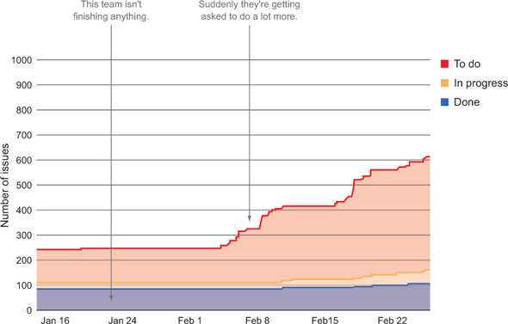
Cumulative Flow
An example cumulative flow diagram showing a team getting asked to do a lot more than they have been able to accomplish historically
Source: Agile Metrics in Action: How to measure and improve team performance by Christopher W. H. Davis , Published by Manning Publications, 2015
28/10/23
SE ZG544 S1-23-24 Agile software processes

Slide 23
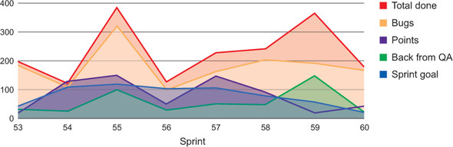
Example - Combination of data
Spikes in this data point can indicate potential problems:
There’s a communication gap somewhere on the team.
Completion criteria (a.k.a. done) are not defined clearly to everyone on the team.
Tasks are being rushed, usually due to pressure to hit a release date.
Source: Agile Metrics in Action: How to measure and improve team performance by Christopher W. H. Davis , Published by Manning Publications, 2015
28/10/23
SE ZG544 S1-23-24 Agile software processes

Slide 24
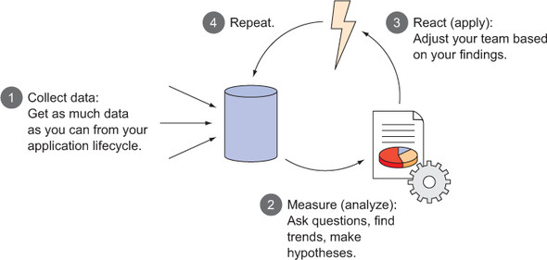
COLLECT, MEASURE, REACT, REPEAT—THE FEEDBACK LOOP
There isn’t a silver-bullet metric that will tell you if your agile teams are performing as well as they can.
Collecting and analyzing data in the form of metrics is an objective way to learn more about your team and a way to measure any adjustments you decide to make to your team’s behavior.
Source: Agile Metrics in Action: How to measure and improve team performance by Christopher W. H. Davis , Published by Manning Publications, 2015
28/10/23
SE ZG544 S1-23-24 Agile software processes

Slide 25
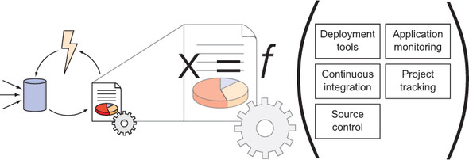
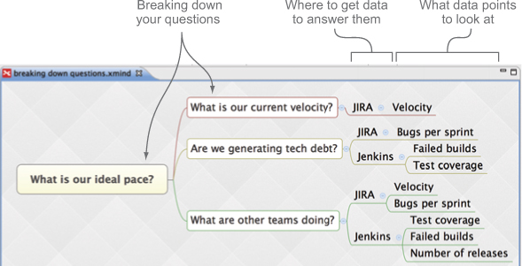
Figuring out what matters
(X is what you want to answer; some combination of your data can get you there.)
Mind mapping is a brainstorming technique where you start with an idea and then keep deconstructing it until it’s broken down into small elements. XMind (www.xmind.net/),
Source: Agile Metrics in Action: How to measure and improve team performance by Christopher W. H. Davis , Published by Manning Publications, 2015
28/10/23
SE ZG544 S1-23-24 Agile software processes

Slide 26
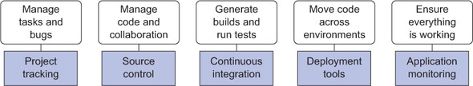
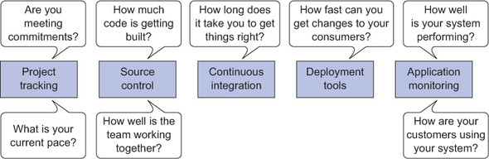
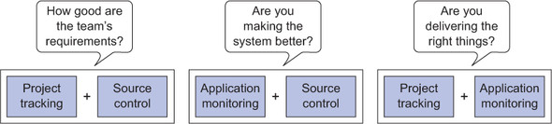
Project performance data
Data is all over the place without a unified view
Questions you can answer with data from systems in your SDLC.
Adding data together to answer high-level questions
Source: Agile Metrics in Action: How to measure and improve team performance by Christopher W. H. Davis , Published by Manning Publications, 2015
28/10/23
SE ZG544 S1-23-24 Agile software processes

Slide 27
Thank you
28/10/23
SE ZG544 S1-23-24 Agile software processes

